Slide 1
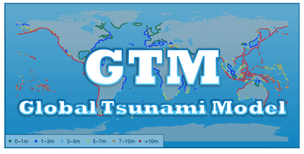

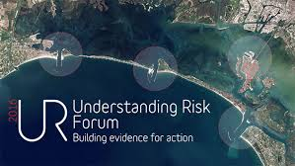


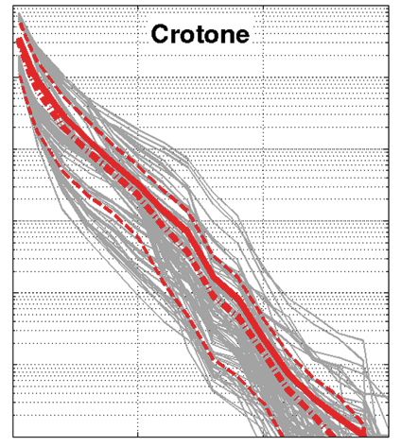
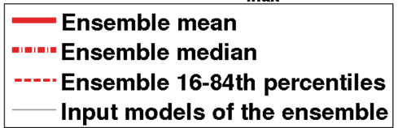
GLOBAL TSUNAMI MODEL (GTM)
Stefano Lorito, INGV, Italy
Finn Løvholt, NGI, Norway
Hong Kie Thio, AECOM, US

Slide 2
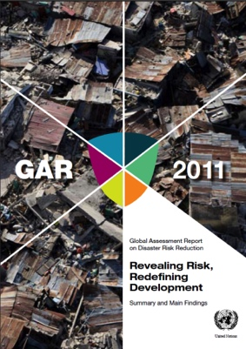
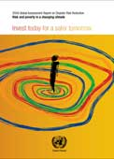
Background and motivation – why did we take this initiative
Gather the scientific community for
Discuss some open issues
Improving methods; sharing tools
Triggered during Multi-institutional work on
hazard and risk for the UN-ISDR
(Global Assessment Report, GAR)
Initiative from the tsunami community itself

Slide 3

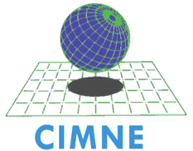

























Gathering the global network
Formalising UNISDR endorsement

Slide 4

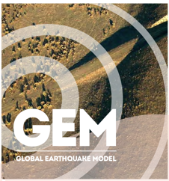
Improved understanding of tsunami hazard and risk
(and related disciplines)
Develop standards and guidelines for probabilistic assessment
Harmonize efforts and products
(e.g. regional data and projects)
Integration of results and tools with related organizations such as GEM and GVM
Reference regional and global hazard/risk models
Basis for multi-hazard risk assessment
(e.g. previous experience in GAR)

Slide 5
Seismic source (probability and modeling)
Non Seismic source (probability and modeling
Tsunami (probability and modelling)
PTHA (seismic and non-seismic→ landslides and volcanoes)
Vulnerability and fragility
Probabilistic Tsunami Risk Assessment
Uncertainty treatment and feasibility
Standards and guidelines for tsunami hazard and risk quantification
Unified code interfaces – harmonization
Dissemination and geoethics (standardized review process – transparency – uncertainty communication)

Slide 6
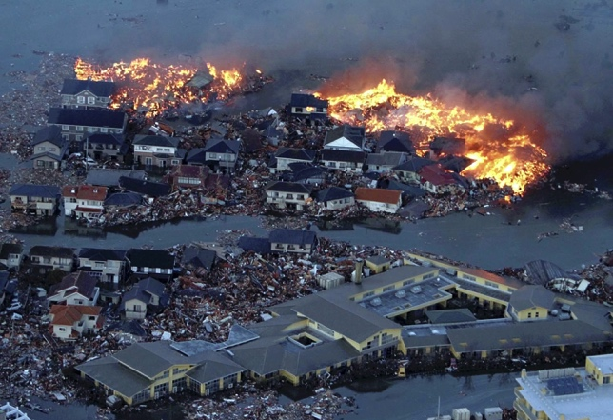
Interested? (further info, joining, support)
Stefano Lorito, INGV, Italy
Finn Løvholt, NGI, Norway
Hong Kie Thio, AECOM, US
stefano.lorito@ingv.it
hong.kie.thio@aecom.com finn.lovholt@ngi.no

